Slide 1


INTERNSHIP MANAGEMENT SYSTEM
Existing problems in internship management include manual processes, communication gaps, data security concerns, and inefficient evaluation. The Internship Management System aims to address these issues by providing an efficient digital solution for streamlined operations, enhanced communication, and improved data security.

Slide 2
Project Overview
Streamlined Internship Management
Effective Communication
Data Security
Robust security measures protect sensitive internship data, giving peace of mind to all stakeholders.
Enhanced communication features allow for seamless collaboration between students, faculty, and the Head of Department (HOD).
The system offers a centralized platform for managing internships, ensuring smooth operations for both students and faculty.

Slide 3
Project Overview
Streamlined Internship Management
Effective Communication
Data Security
Robust security measures protect sensitive internship data, giving peace of mind to all stakeholders.
Enhanced communication features allow for seamless collaboration between students, faculty, and the Head of Department (HOD).
The system offers a centralized platform for managing internships, ensuring smooth operations for both students and faculty.

Slide 4

Video
Experience a walkthrough of the Internship Management System in action. See how it revolutionizes internship management and improves student and faculty experiences.

Slide 5

Tools Utilized
1
Django
2
JavaScript
A powerful Python web framework that provides a solid foundation for the Internship Management System.
Used to enhance user interactions and add dynamic features to the system.
3
Bootstrap
A popular front-end framework that ensures a responsive and visually appealing user interface.

Slide 6
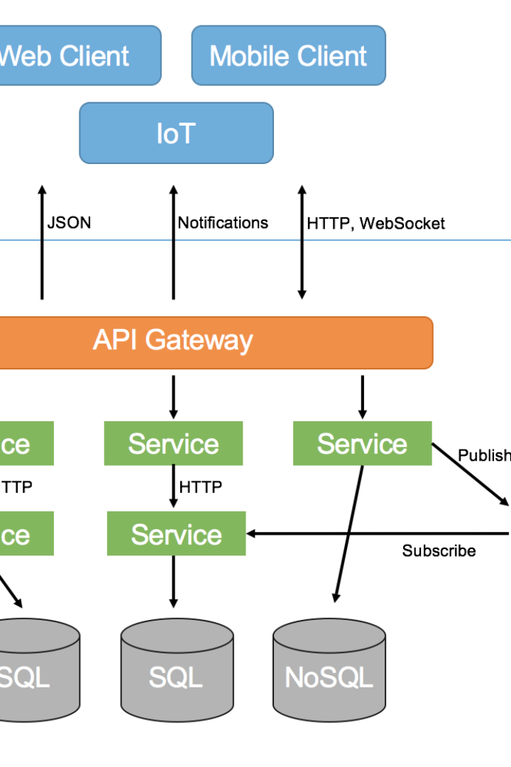
Class Diagram
Get an overview of the system's structure and relationships through the visual representation of the class diagram.

Slide 7
Student Faculty Mapping Algorithm
1
Efficient Faculty Assignment
An advanced algorithm assigns students to faculty based on their designation, ensuring fair and appropriate mentorship.
Optimal Workload Distribution
2
The mapping algorithm intelligently distributes students among faculty members to achieve balanced workloads.
3
Enhanced Learning Experience
Students benefit from personalized guidance and mentorship, tailored to their specific internship goals.

Slide 8

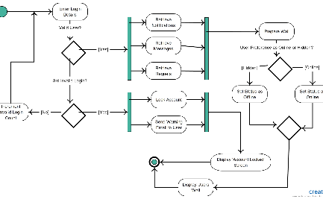
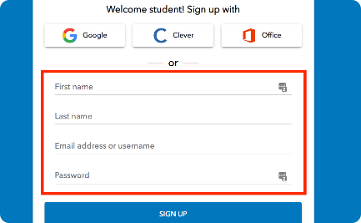
Student Use Case and Activity Diagram
Student Use Case
Activity Diagram
Student Login
Understand the various functionalities and actions available to students within the Internship Management System.
Visualize the step-by-step flow of actions and decisions for students as they navigate the system.
Learn about the secure login process for students and the functionalities accessible after authentication.

Slide 9
Faculty Use Case and Activity Diagram
Faculty Use Case
Activity Diagram
Faculty Login
Discover the key features and interactions available to faculty members within the Internship Management System.
Follow the logical flow of actions and decisions for faculty as they perform their duties using the system.
Explore the login process tailored for faculty members, granting access to their specific functionalities.

Slide 10

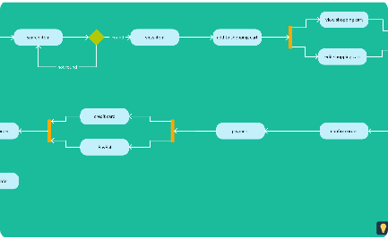
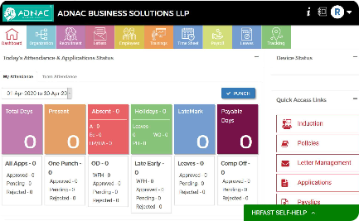
Head of Department (HOD) Use Case and Activity Diagram
HOD Use Case
Activity Diagram
HOD Login
Gain insights into the powerful administrative features and responsibilities available to the Head of Department.
Understand the series of actions and decisions the HOD can take within the Internship Management System.
Learn about the secure authentication process available to the Head of Department and the administrative functionalities accessible after login.

Slide 11

Django Backend - Admin User
1
Admin User Management
2
Data Analysis and Reporting
3
System Configuration
Discover how the Django admin interface allows for easy management of users and their roles within the system.
Explore the capabilities of the admin user in generating insightful reports and extracting valuable data from the system.
Learn about the flexibility and customization options available to the admin user for fine-tuning the Internship Management System.

Slide 12
Future Scope
Enhanced Reporting
Integration of Evaluation Tools
Industry Partnerships
Continuously improve the reporting capabilities to provide valuable insights for internships and performance evaluations.
Integrate assessment and evaluation tools to streamline the feedback process and enhance internship outcomes.
Forge partnerships with industry leaders to provide students with more diverse internship opportunities.

